Slide 1
Duplicate these slides for your class
Review teacher notes.
Edit homework/announcements slide accordingly.
Update and email session agenda
Starter Code
Example Project
Make sure to review and update the Kahoot!
Notes:
Teacher Notes:
This slide needs to be deleted once you’ve completed your preparation. Copy these slides to your team’s drive and do not link the originals to the Daily Session Document.
Lesson Planning Checklist here

Slide 2
In this unit, coders will build a family tree project using React. Coders will be introduced to the React framework and build components to showcase a family of their choice. This project is intended to highlight some important aspects of goal setting and project management. The project will culminate in a final presentation.
Notes:
Teacher Notes:
This slide needs to be deleted once you’ve completed your preparation. Copy these slides to your team’s drive and do not link the originals to the Daily Session Document. Make sure to PRINT the project planning document.

Slide 3
Notes:
This slide needs to be deleted once you’ve complete your preparation. Copy these slides into your team’s drive and edit them according to the needs of your class. Remember to use YOUR copy of the slides when you post to Google Classroom.

Slide 4
React Class

Slide 5
组件
(5 m)
组件是可重用的模板，可加快开发速度，并提供一种简便的方法来创建更复杂的Web应用程序。
Notes:
Review last class

Slide 6
JSX
(5 m)
JavaScript eXtension, a.k.a JSX，是一个React扩展，允许我们在JS里写HTML。
class HelloWorld extends React.Component { render() {
return ( <h1 className='large‘>
你好！
</h1>
);
} }
Notes:
Teacher Notes:

Slide 7
React Class
请打开代码 0-basic
npm install
剪切（Cmd+x）、粘贴（Cmd+v）
node_module目录
npm start

Slide 8
打开 src 下的 App.jsx 文件
class：类
extends：继承
render：显示

Slide 9
React VS Code Debug

Slide 10
React VS Code Debug
https://code.visualstudio.com/docs/nodejs/reactjs-tutorial
安装插件
设置launch.json

Slide 11
React VS Code Debug
安装 Chrome Debugger 扩展

Slide 12
React VS Code Debug
设置launch.json
进入“Run”小蜘蛛
点击“齿轮”，修改 launch.json
https://code.visualstudio.com/docs/nodejs/reactjs-tutorial

Slide 13
设置 launch.json
{ "version": "0.2.0",
"configurations": [
{ "type": "chrome",
"request": "launch",
"name": "Launch Chrome against localhost",
"url": "http://localhost:3000",
"webRoot": "${workspaceFolder}"
} ] }
https://code.visualstudio.com/docs/nodejs/reactjs-tutorial

Slide 14
React VS Code Debug
启动终端，npm start 启动程序
设置断点
F5
就可以Debug了
单步调试，观察变量

Slide 15
React 组件参数传递

Slide 16
函数参数
function 说(话) {
console.log(话）
}
说(“你好！”)
Notes:
Teacher Notes:
https://docs.google.com/presentation/d/1ACBiCv6xe5QCxaWXW6VO1Gj4cnKhm4WBS_ySdFtcoYo/edit?usp=sharing

Slide 17
函数参数
写一个函数“今天”，输出今天日期
今天(11,1)
“今天是11月1日”
Notes:
Teacher Notes:
https://docs.google.com/presentation/d/1ACBiCv6xe5QCxaWXW6VO1Gj4cnKhm4WBS_ySdFtcoYo/edit?usp=sharing

Slide 18
函数参数
function today(month, date) {
console.log(“今天是 " +
month + ", " + date);
}
Notes:
Teacher Notes:
https://docs.google.com/presentation/d/1ACBiCv6xe5QCxaWXW6VO1Gj4cnKhm4WBS_ySdFtcoYo/edit?usp=sharing
需要permission

Slide 19
React组件也可以有参数
...今天我们会发现！
Notes:
Teacher Notes:
Skip if you wish!
Solution for Do Now: https://popcode.org/?snapshot=0b04b8ad-d5d7-4bde-a43f-90fa013c2459

Slide 20
使用React props（道具）在组件之间传递数据。
Vocabulary: props

Slide 21
props
就像函数一样，组件接受参数输入（称为“ props”），并返回要显示的网页元素
props是传入组件的参数，类似于函数的参数

Slide 22
为什么用props?
使组件更可重用
加快发展
提供一种简便的方法来创建更复杂的Web应用程序
根据不同的用户数据或实时信息简化开发

Slide 23
没有参数
(5 m)
class App extends React.Component {
render() {
return (
<Cat />
);
}
}
标题组件：显示带有文本“首页”的h1
class Cat extends React.Component {
render() {
return (
<h1 className="title">
我的主页
</h1>
);
}
}
https://repl.it/@sayri/SimplePropsExample
Notes:
Teacher notes:
Point out that props for this simple example aren't very useful

Slide 24
传入参数
(5 m)
class App extends React.Component {
render() {
return (
<Cat name={“科蚪之猫”}/>
);
}
}
使用道具，我们可以编写代码以选择标题：
class Cat extends React.Component {
render() {
return (
<h1 className="title">
{this.props.name}
</h1>
);
}
}
https://repl.it/@sayri/SimplePropsExample
Notes:
Teacher notes:
Point out that props for this simple example aren't very useful

Slide 25
对比
(5 m)
不能指定显示文本
class App extends React.Component {
render() {
return (
<Title />
);
}
}
指定显示文本
class App extends React.Component {
render() {
return (
<Title 标题={“我的主页”}/>
);
}
}
https://repl.it/@sayri/SimplePropsExample
Notes:
Teacher notes:
Point out that props for this simple example aren't very useful

Slide 26
对比
(5 m)
总是显示同样的文本
class Title extends React.Component {
render() {
return (
<h1 className="title">
我的主页
</h1>
);
}
}
显示指定的文本
class Title extends React.Component {
render() {
return (
<h1 className="title">
{this.props.标题}
</h1>
);
}
}
https://repl.it/@sayri/SimplePropsExample
Notes:
Teacher notes:
Point out that props for this simple example aren't very useful

Slide 27
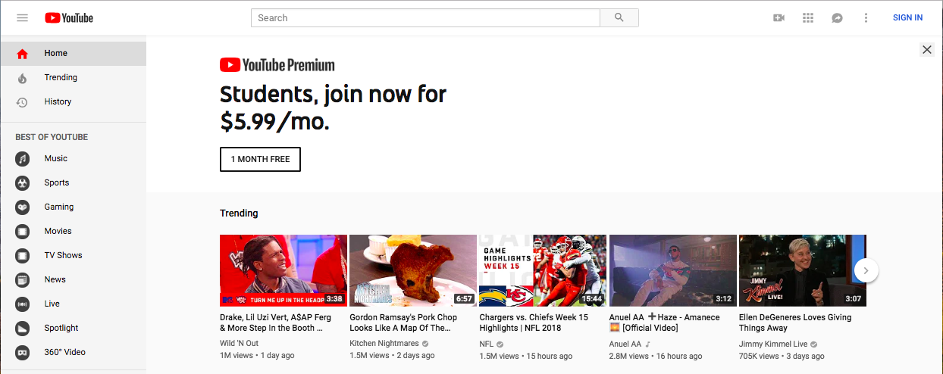
例
(5 m)
Notes:
Which of these components might use props?

Slide 28
例
(5 m)
通过参数传入，指定显示文本：“Music”音乐
Notes:
Teacher notes:
Remind coders about the page we were creating components for

Slide 29
课堂练习
1-number
我喜欢的电话号码

Slide 30
课堂练习
2-question-props
生命的意义

Slide 31
课堂练习
3-flag
旗子的颜色
Component（组件目录）

Slide 32
课后练习
4-ex-shopping-cart
购物车
修改App.js
按照代码中的注释，完成修改

Slide 33
组件数组

Slide 34
组件数组
5-sidebar
四种方案
hardcode
for
for组件
map

Slide 35
例：边栏（Sidebar）
(15 m)
class Sidebar extends React.Component {
render() {
return (
<div className="sidebar">
<SidebarItem />
<SidebarItem />
...
</div>
);
}
}
class SidebarItem extends React.Component {
render() {
return (
<div className="sidebar-item">
SidebarItem
</div>);
}
}
SidebarItem
SidebarItem
SidebarItem
SidebarItem
https://repl.it/@JazbelWang/React-1
Notes:
Notice that the SidebarItems are all with the text SidebarItem. Whereas the previous slide, the SideBarItems look all the same but have different text?
https://repl.it/@JazbelWang/React-1

Slide 36
Props: Sidebar + Props （hardcode）
(15 m)
var items = ["Home", "Trending", "History", "Music"];
class Sidebar extends React.Component {
render() {
return (<div className="sidebar">
<SidebarItem title={items[0]} />
<SidebarItem title={items[1]} />
...
</div>);
}
class SidebarItem extends React.Component {
render() {
return (<div className="sidebar-item">{this.props.title}</div>);
}
}
Home
Trending
History
Music
https://repl.it/@JazbelWang/React-2
Notes:
https://repl.it/@JazbelWang/React-2
Students can fork it and add more sidebaritems to match the screenshot

Slide 37
Props: Sidebar + Props （for）
(15 m)
var items = ["Home", "Trending", "History", "Music"];
class Sidebar extends React.Component {
render() {
let s_items = [];
for (let i in items) {
s_items.push(<SidebarItem title={items[i]} />);
}
return (<div className="sidebar">{s_items}</div>); }
}
class SidebarItem extends React.Component {
render() {
return (<div className="sidebar-item">{this.props.title}</div>); }
}
Home
Trending
History
Music
https://repl.it/@JazbelWang/React-3
Notes:
Demo: https://jsbin.com/fefuroceyu/1/edit?html,js,output
https://repl.it/@JazbelWang/React-3

Slide 38
课后练习
6-ex-weather
修改 WeeklyWeatherForecast.js 文件，完成下面两个填空

